Slide 1
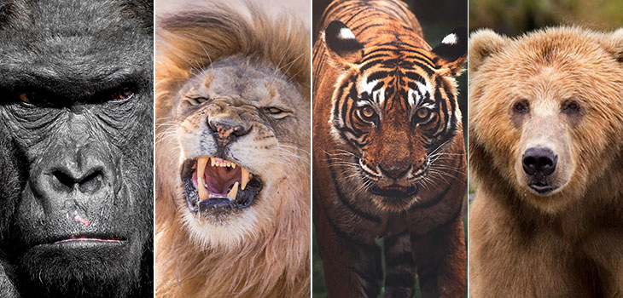
Captive Wildlife Critical Incident & Natural Disaster Response
Lt. Louis Hinds IV 941-224-5634
Louis.hinds@myfwc.com
Notes:
Introduce yourself as well as discuss your law enforcement and captive wildlife experience.
Ask what they know or if they know anything about captive wildlife in the state of Florida. One or some might have previous knowledge or experience with captive wildlife.

Slide 2
What is Captive Wildlife
Rule 68A-1.004(18), Florida Administrative Code (F.A.C.) defines captive wildlife as:
  Any wildlife, specifically birds, mammals, reptiles, and amphibians maintained in captivity for exhibition, sale, personal use, propagation, preservation, rehabilitation, protection or hunting purposes.

Slide 3
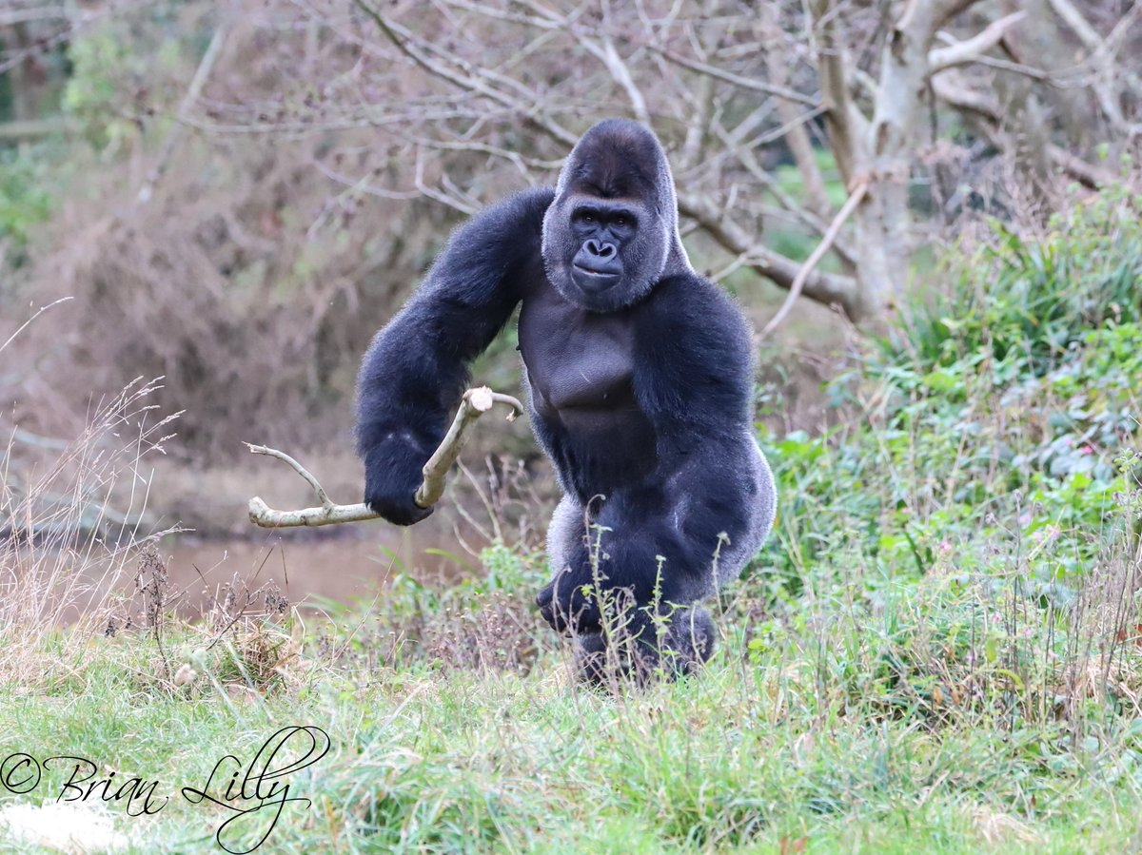
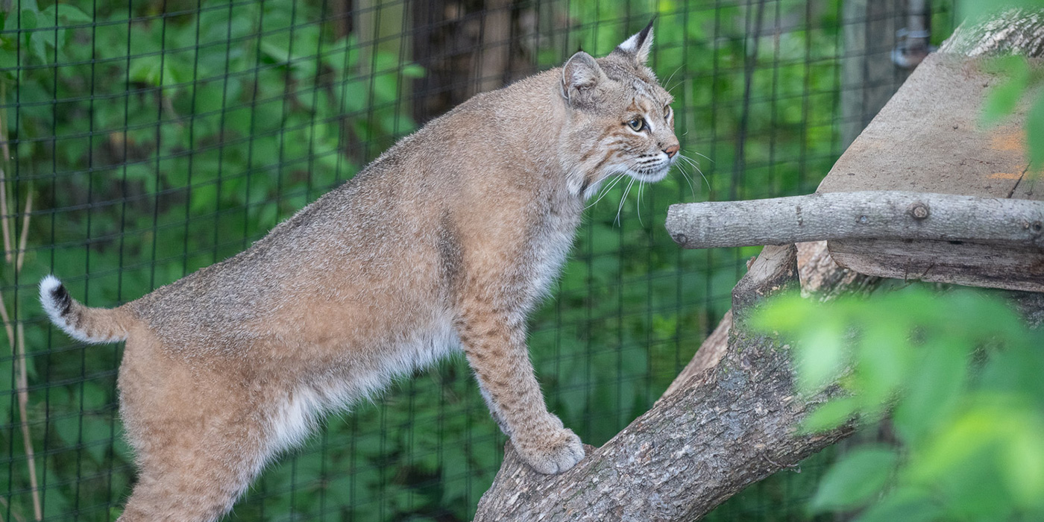
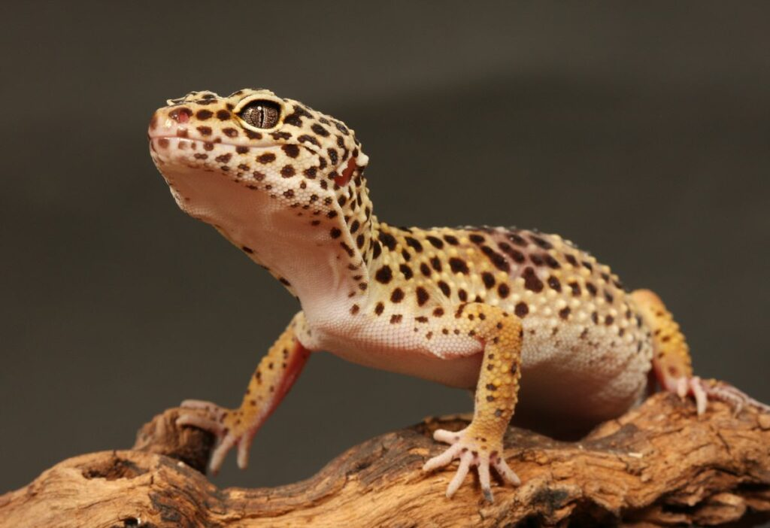
Classes of Captive Wildlife
Class I
  Wildlife which because of nature, habits, or status, shall not be possessed as a personal pet.
Class II
  Wildlife considered to present a real or potential threat to human safety.
Class III
  All other wildlife not included in Class I or Class II.
Notes:
Class I can kill you
Class II can severely hurt you
Class III is everything else and includes venomous reptiles
Have designated lists in 68A-6.002 which details which animals are class I & II

Slide 4
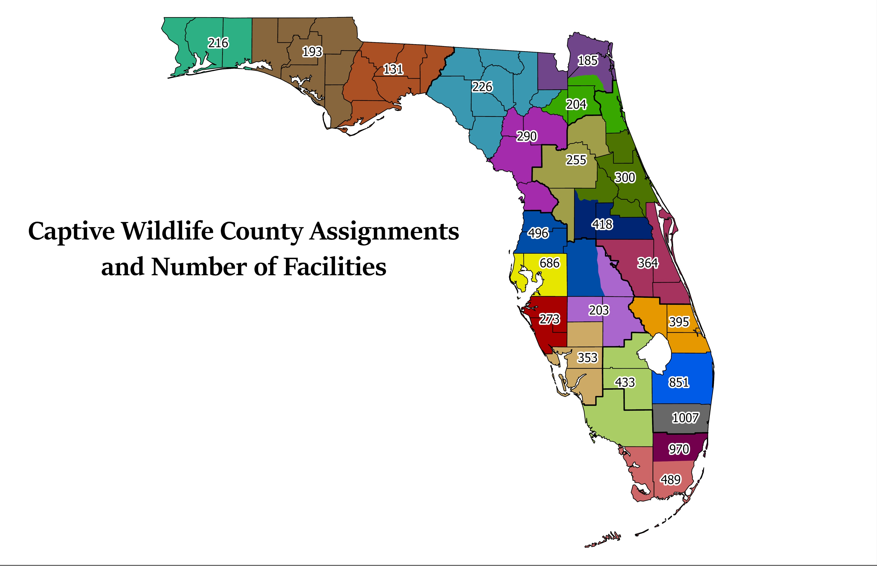
Captive Wildlife & Where it’s located
Captive wildlife is everywhere in Florida!
  Zoo’s
  Deer farmers
  Reptile keepers
  Hobbyist possessor’s and personal pets
Notes:
Florida is a tourism state
Many different types of facilities that have wildlife and cater to tourists
Healthy deer industry
Huge reptile and amphibian industry
Florida’s climate and ecosystem is excellent for all types of wildlife to thrive as evidenced by the Burmese python

Slide 5
Captive Wildlife Critical Incidents
Critical Incident is defined as an incident resulting in the severe injury or death suffered by any person, to include any severe bite, mauling or envenomation, caused by a Class I or II wild animal, venomous or dangerous reptile; or the escape of any Class I or II wild animal, exotic venomous or dangerous reptile from the licensed facility or when an escape places the public at risk of harm: or a natural disaster event such as a flood, earthquake, wildfire, or hurricane that causes great damage to property or loss of life.
Notes:
1. The primary responsibility for the recapture of any escaped Class I or II wildlife or exotic venomous reptile will be borne by the licensee.
2. The Investigator responsible for investigating such incident will work with the licensee to coordinate recapture of escaped wildlife using the licensee’s Critical Incident and Disaster Plan as a guide.
This may not be feasible or responding personnel may need to adapt to the circumstances

Slide 6
Policy
Provide a prompt and safe response to any captive wildlife critical incident, ensuring the safety and welfare of the public, FWC staff and wildlife to the greatest extent possible in consideration of circumstances specific to a given incident.
This mission is best accomplished through the implementation of an organized response through Incident Command System (ICS) operating procedures
ICS procedures are detailed in Captive Wildlife Critical Incident SOP’s

Slide 7
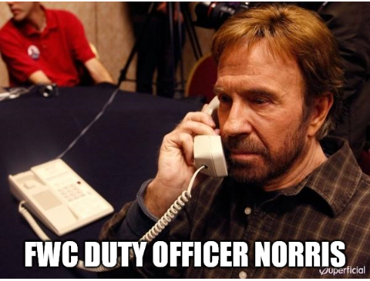
When the call comes in
Dispatch
Passerby/Neighbor report escape *
Licensee notifies investigator *
Media tip
Other agencies
  State Agencies
  County Sheriff
  Local police dept
Notes:
Notification
can be received by various means.
Be Ready
When it does happen implement the incident command system.
What’s that?

Slide 8
Responding to Critical Incidents
Incident Command System
  A flexible incident management approach that allows for the integration of personnel, equipment, facilities, procedure and communication within a unified organizational structure and enables a coordinated response among various entities

Slide 9
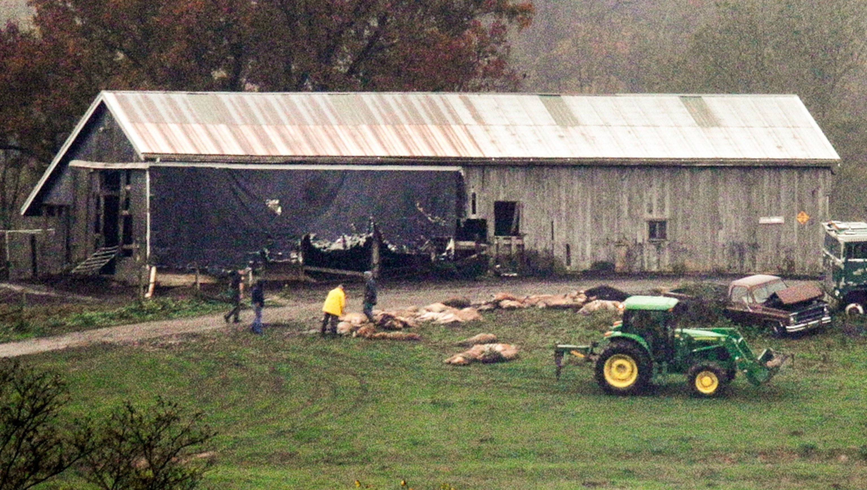
Why we need to be prepared
Zanesville, Ohio - 2011
https://www.youtube.com/watch?v=u4rnchDmGMU
Notes:
Also include other instances:
Miami, FL - 2018
Chimpanzee Escape
Ocala, FL – 2019
Lion Escape

Slide 10
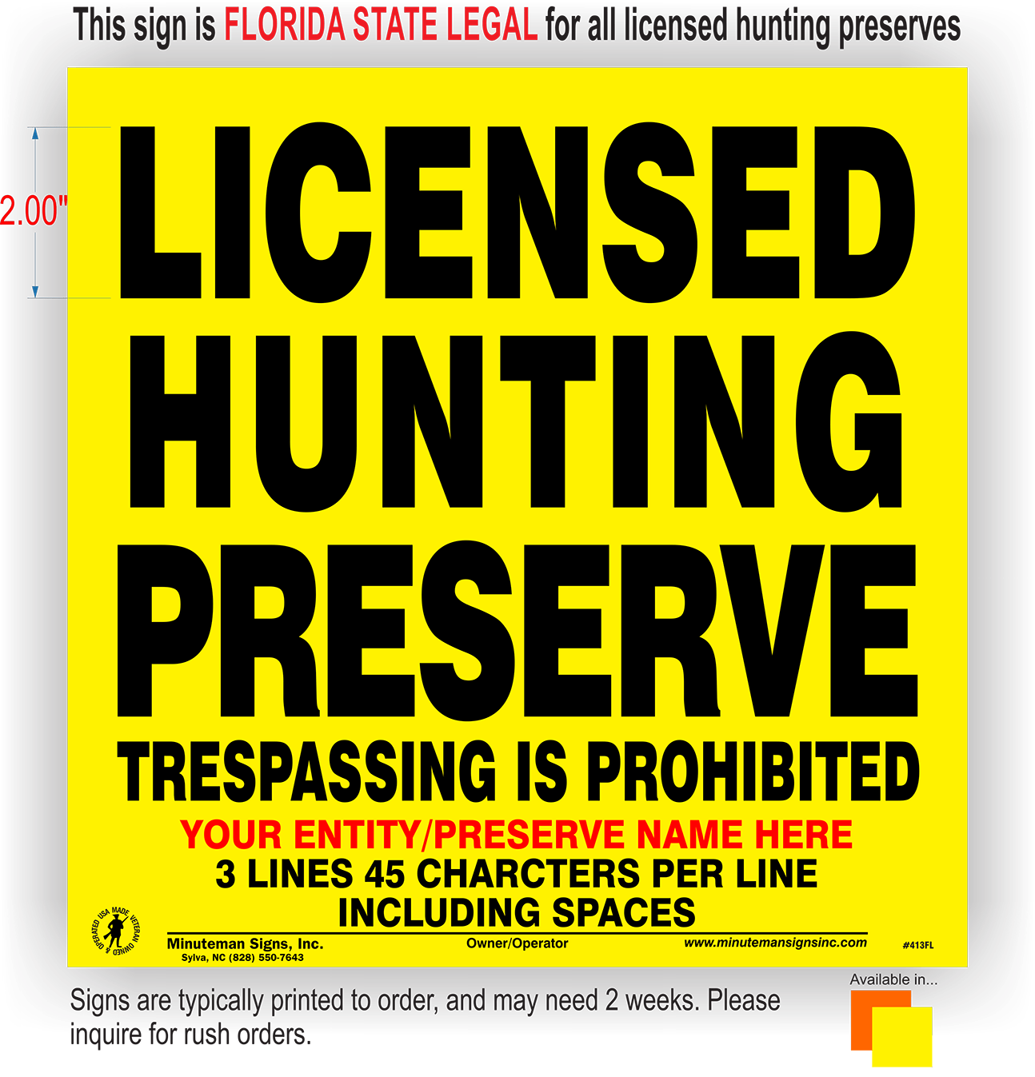
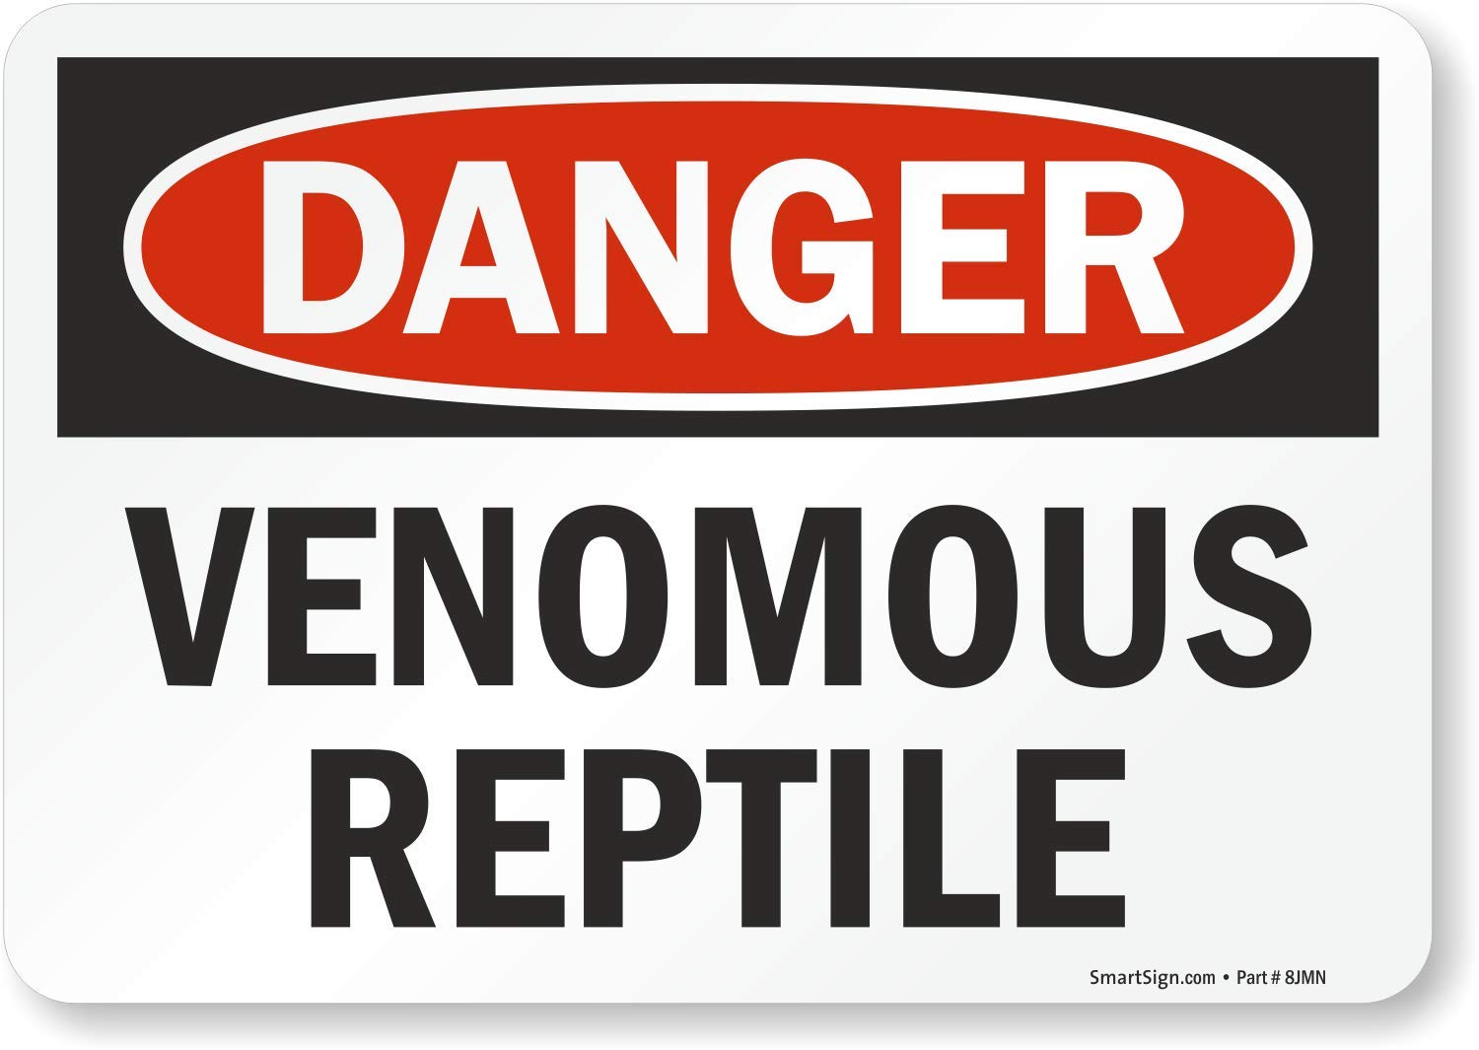
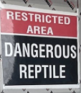

What to look for
Notes:
Requirements in rule that certain types of facilities have signage posted detailing what wildlife is in facility

Slide 11
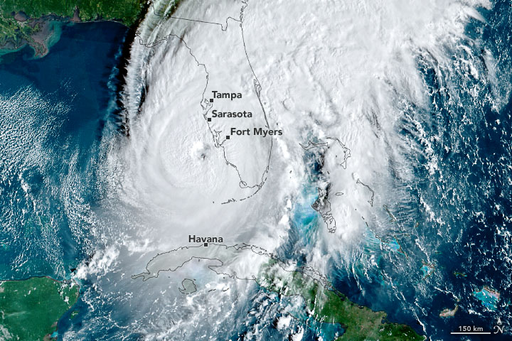
Natural Disasters
Hurricanes
Flooding
Fire
Notes:
FWC Deployment waves with CW Response teams
Team of captive investigators and Lt’s attach to a deployment and operate in impacted areas
Contact effected facilities
Assess facilities
Relay information out
Capture / relocate animals as needed
Chemical Capture
Kill guns
Traps / Cages

Slide 12
Coordination
SEOC – State Emergency Operations Center
  ESF Room 16 Law enforcement
  ESF Room 17 Animal Protection
EOC’s – Local Emergency Operations Centers
Notes:
Captive Wildlife Response Teams
Coordinate with on scene incident commander and SEOC Captive Wildlife contact (Section Leader )
Information funneled through ESF 16/17 for operational needs
ESF = Emergency Support Function

Slide 13
Operational needs
Logistics
Communications ( Plan for them not to work)
Equipment needs
  specialty equipment ( ATV, 4WD, Swamp Buggies, you name it we got it.
  other agency response ( communication can be an issue)
Notes:
During natural disasters there may be affected facilities which require tree removal or electrical work – downed power lines / trees
Large inventory of animals that may need to be evacuated

Slide 14
Resources
Lt. Bryant Hughes 850-653-6947
Facility list request to cwapps@myfwc.com
Regional/County Contacts
  Northwest and Northeast: Lt. Tyler Harrison 850-510-0661
  Central Florida to the East Coast: Lt. Chris Urban 772-985-9000
  Southwest: Lt. Louis Hinds 941-224-5634
  South Florida: Lt. John Garzaniti 561-670-5530

Slide 15

Questions

